Slide 1
Web Scraping for SEO
Drew Wilson

Slide 2
Web Scraping for SEO
AKA How not to get blocked by Google
Drew Wilson

Slide 3
Crawling vs Scraping
Crawling
Scraping
About finding pages on the world wide web
Google’s crawlers (spiders) traverse the internet to index sites
Goal is to learn what sites are about so that information can be retrieved when needed
About extracting data from webpages
Goal is to parse important information from a specific site

Slide 4
Is web scraping legal?
YES! (kinda)
Just follow scraping etiquette

Slide 5
Scraping etiquette
Respect the robots
Login protected data
Careful with copyrights
Obey the rules set in the robots.txt file
If you have to bypass any login pages, you probably shouldn’t be accessing that data with a bot
Be sure not to scrape anything protected by copyright
Terms & Conditions
Slow your horses
As a scraper, you are a user, and you agree to the terms and conditions of the site
Make it clear you aren’t DOSing anyone, don’t slam the servers with excessive requests

Slide 6
Basically, don’t be a burden

Slide 7
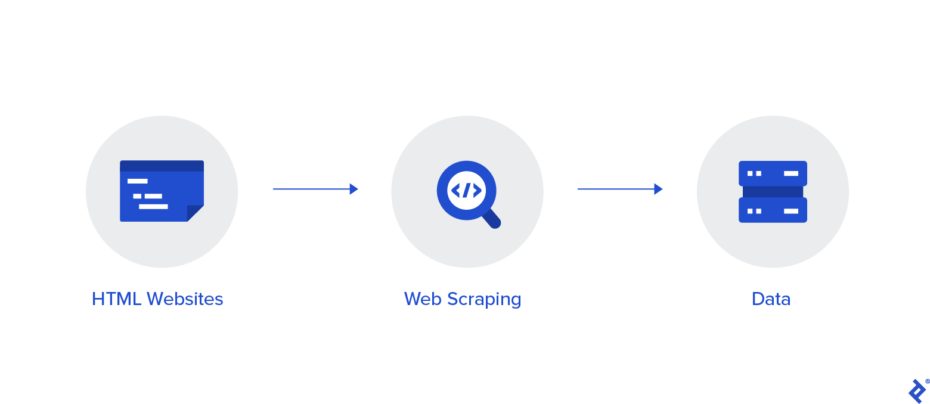
How to scrape a website
Short answer- Python!
Inspect element
Get the HTML
Extract your data

Slide 8
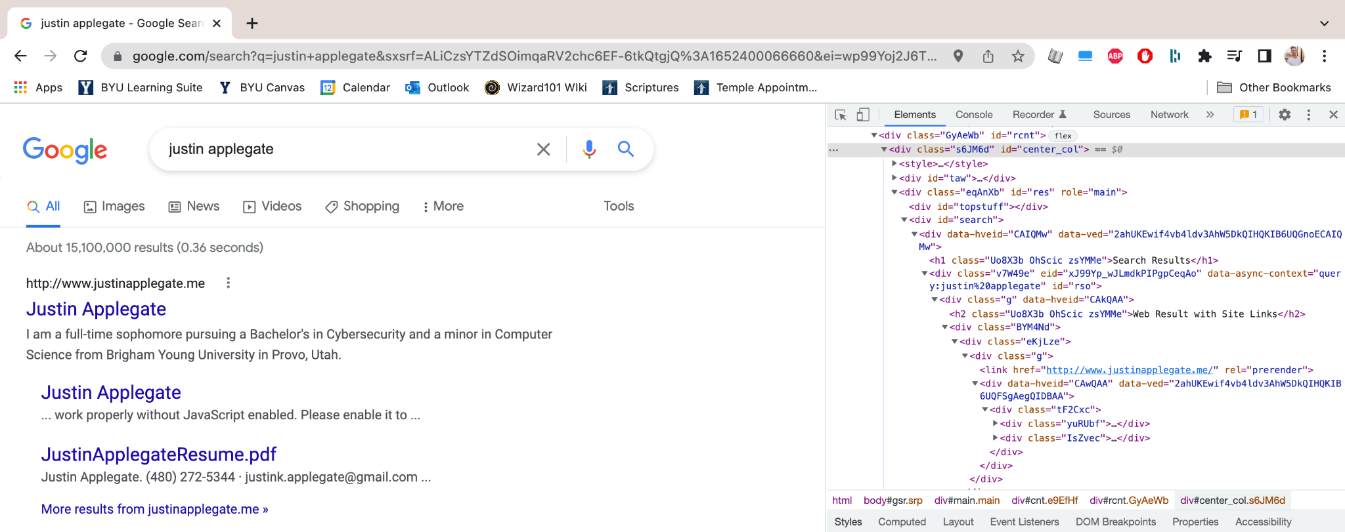
1- Inspect element

Slide 9
2- Get the HTML
Install and import the requests library
Specify url and headers
Make a GET request
Get the response text

Slide 10
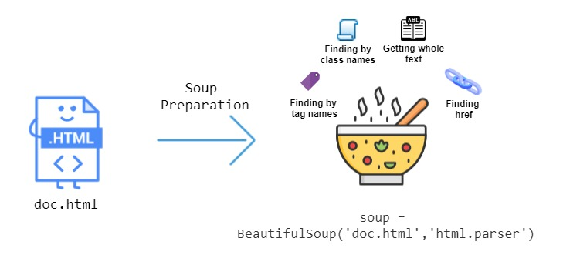
3- Time for soup
Good functions to know
BeautifulSoup(content, “html.parser”)
soup.find(“div”, id=”div-id”)
Can also find by class
soup.find_all(“a”)

Slide 11
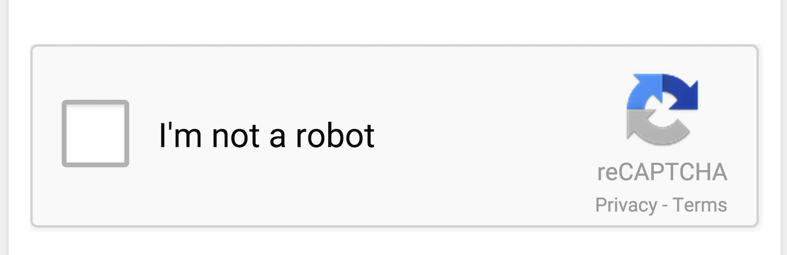
Now for the hard part...

Slide 12
Scraping when Google doesn’t like it
User-Agent
Other headers
Proxy rotation
Set and rotate your user agent
Having a full set of headers looks more normal
Get around that IP rate limiting
Delay
Headless browsers
Changing structure
Making your robot slower makes it look less like a robot
Technically a ‘real browser’ - just change your user agent
Code thoughtfully and defensively

Slide 13
References / Resources
https://github.com/kahuku/SEO_Scraping
https://towardsdatascience.com/web-scraping-basics-82f8b5acd45c
https://www.scrapehero.com/how-to-prevent-getting-blacklisted-while-scraping/
https://www.geeksforgeeks.org/web-scraping-without-getting-blocked/
https://www.parsehub.com/blog/what-is-web-scraping/
https://dev.to/dmitryzub/how-to-reduce-chance-being-blocked-while-web-scraping-search-engines-1o46#add_headers
https://www.zenrows.com/blog/stealth-web-scraping-in-python-avoid-blocking-like-a-ninja#ip-rate-limit

